Slide 1
Latin America and Education
Alex Cruz

Slide 2
Facts
Latin Americans, on average, receive six years of formal schooling
50 Million Latin Americans cannot read or write
92% of all Latin American children start primary school, of those, only 32% continue to secondary school
Per capita spending, Latin American levels are 15% of what US spends on primary education
2001, on average 23% of Latin Americans from 18 to 24 were enrolled at the college/university level

Slide 3
Economic Impact
Relation of quantity/quality of education and income
Relation of standardized test scores with income
The higher the expertise, the higher the pay
Innovation
Entrepreneurial Mechanics
Engender a stronger domestic currency through international competitiveness (Inflation check)
Decrease in income inequality

Slide 4
Performance and Inequality
PISA 2000 Math Scores
600
500
Average Score
400
300
Rich to Poor Ratio

Slide 5
Percentage Living under $2 a Day
East Asia/The Pacific
Latin America

Slide 6
Social Impact
Health Conditions
Infant Mortality
Age of Marriage
Civil Participation
Criminality
Tolerance
Prestige for Education System

Slide 7
Distribution of University Students In 25% Income Brackets
Brazil Mexico Colombia Chile US Argentina

Slide 8
Political Impact
Builds Interest Groups
More Infrastructure Savvy
A greater pool of attorney, judges and public defenders
Give rise to contrasting political parties

Slide 9
Education Obstacles
Parent’s Education
School Infrastructure
Agricultural Calendar
Accessibility to Higher Education
Free tuition only to those in need
Fluctuations in tax revenue
High Education levels and Low Civil Liberties Possible: Iraq, Cuba

Slide 10
Education Cycle

Slide 11
Proactive Government
Brazil: Bolsa Familia, where parents are paid $45 dollars a month to keep their children in school
Since many cannot parents cannot read, parents should be required to attend meetings
Build a proactive infrastructure of schools and transportation

Slide 12
Liberty of Education
Public Schools cannot have a religious, political, or demographic propaganda EX. Cuba
Build up the esteem of being a Professor by increasing wages and staff at his/her disposal
Allow open discourse and amnesty to discussion on campuses

Slide 13
Greater Skills
Once a person graduates, a person’s skills will be more marketable
The legislature should create strong anti-discrimination laws to protect the public and government interests
Punitive Damage laws should be used by the courts to act as a deterrent

Slide 14
Greater Equality
Relation of higher expertise, the higher the pay
Will keep currency strong through competitiveness and keep inflation in check
The more the general population is schooled, the greater the equality
Entrepreneurial Mechanics

Slide 15
Civil Rights and beyond…
Using Marshall’s model, the equality of rights came from the emergence of a new middle class
Greater equality means more property ownership
Laws emanate from and to protect property
Once civil rights are established, it creates a launching pad for social rights, i.e. Medicare, Disability Benefits

Slide 16
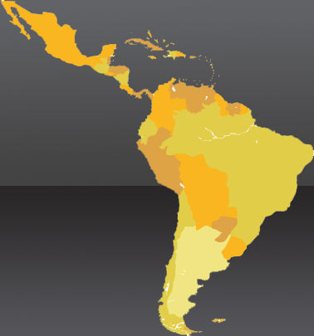
Questions?

